Slide 1


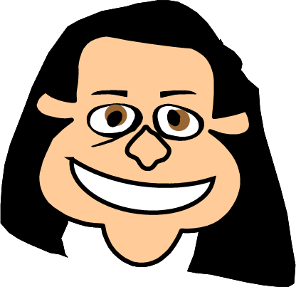
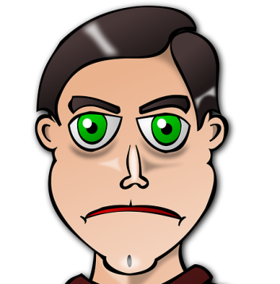
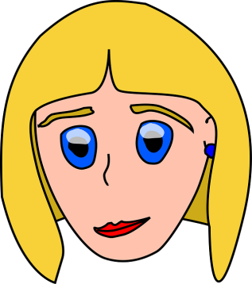

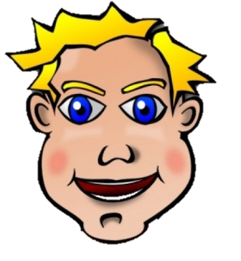
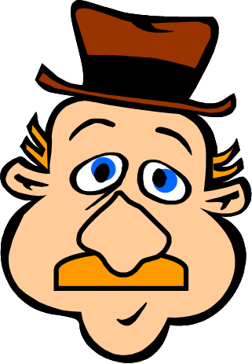
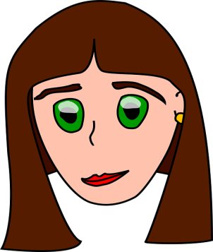
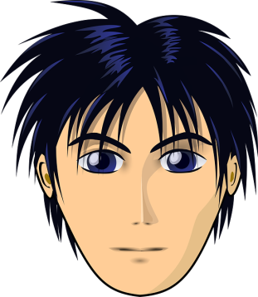
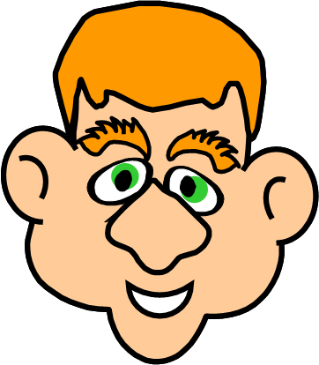
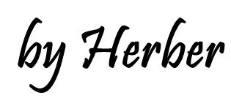

Slide 2
Click on the correct name
CHARLES
PETER
MARGE
MEGAN
JENNY
GREG
PAUL
JOHN
It has got green eyes, thick eyebrows, short hair,
a big nose and big ears. Who is it?
1/6

Slide 3

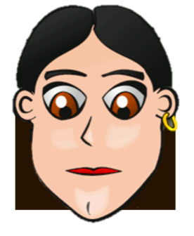
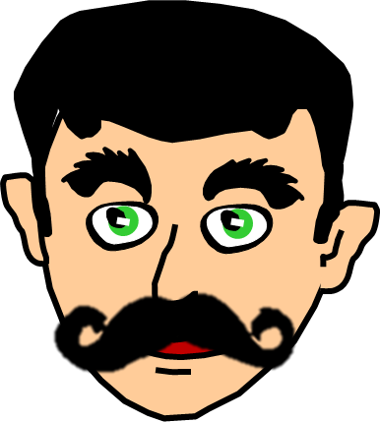
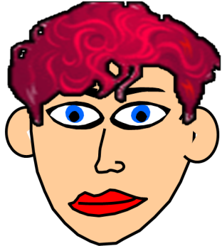

Click on the correct name
BETTY
PAUL
NORA
MEGAN
JENNY
GEORGE
JAMES
JOHN
It has got blue eyes, thin eyebrows, red curly hair, a small nose and big ears. Who is it?
2/6

Slide 4

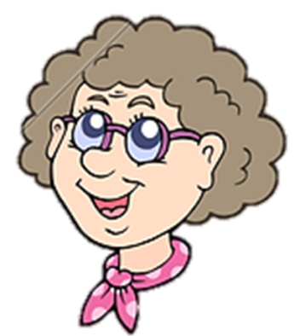

Click on the correct name
BETTY
GREG
ROSE
MEGAN
NORA
GEORGE
JENNY
JOHN
It has got green eyes, thin eyebrows, brown long curly hair and a small nose. Who is it?
3/6

Slide 5

Click on the correct name
BETTY
GREG
NORA
MEGAN
JOHN
LISA
JENNY
GEORGE
It has got green eyes, thick eyebrows, dark short hair and a big moustache. Who is it?
4/6

Slide 6
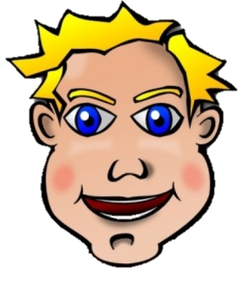
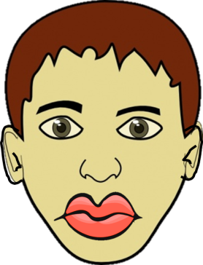
Click on the correct name
BETTY
GREG
JOHN
MEGAN
ROBERT
LISA
JENNY
ROSE
It has got blue eyes, thin eyebrows, fair short hair and a big mouth. Who is it?
5/6

Slide 7
Click on the correct name
BETTY
GREG
MARGE
MEGAN
ROBERT
LISA
JENNY
NORA
It has got brown eyes, thin eyebrows, brown short hair, a small nose and thick lips. Who is it?
6/6

Slide 8

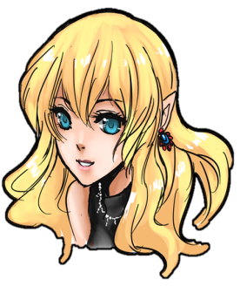
It has got blue eyes, thin eyebrows, fair short curly hair,
a small nose and a small mouth.
A
It has got blue eyes, thin eyebrows, fair short straight hair, a small nose and a small mouth.
B
It has got blue eyes, thin eyebrows, fair short straight hair, a big nose and a small mouth.
C
Click on the correct letter

Slide 9
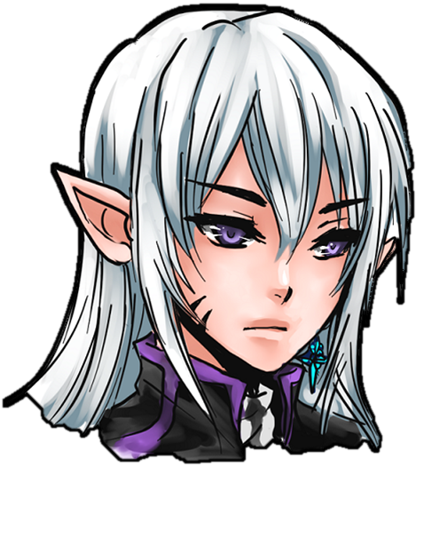
It has got purple eyes, thin eyebrows, white straight hair, a small nose and small ears.
A
It has got purple eyes, thin eyebrows, white straight hair, a big nose and big ears.
B
It has got purple eyes, thin eyebrows, white straight hair, a small nose and big ears.
C
Click on the correct letter

Slide 10
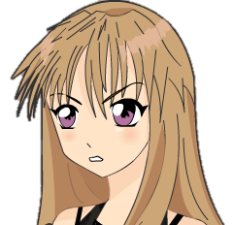
She has got pink eyes, thin eyebrows, light brown curly hair and a long nose.
A
She has got pink eyes, thin eyebrows, dark brown straight hair and a long nose.
B
She has got pink eyes, thin eyebrows, light brown straight hair and a long nose.
C
Click on the correct letter

Slide 11

She has got blue big eyes, thin eyebrows, white short hair and
big ears.
A
She has got blue big eyes, thick eyebrows, white short hair and
small ears.
B
She has got blue big eyes, thin eyebrows, white long hair and
big ears.
C
Click on the correct letter

Slide 12
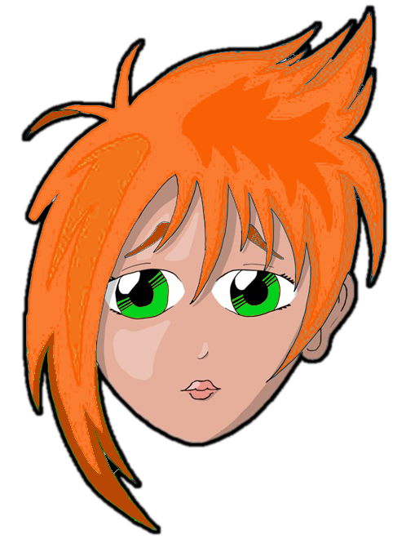
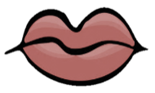
She has got green big eyes, red straight hair and thin lips.
A
She has got green big eyes, red straight hair and thick lips.
B
She has got green big eyes, red curly hair and thin lips.
C
Click on the correct letter

Slide 13

HEAD
It has got an oval head

Slide 14
HAIR
It has got short brown hair

Slide 15
EYEBROWS
It has got thick eyebrows

Slide 16
EYES
It has got blue eyes

Slide 17
NOSE
It has got a big nose

Slide 18
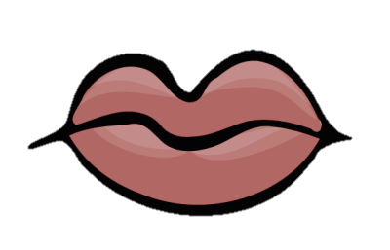
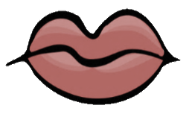
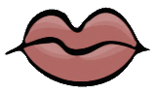
MOUTH/LIPS
It has got a small mouth with thick lips

Slide 19
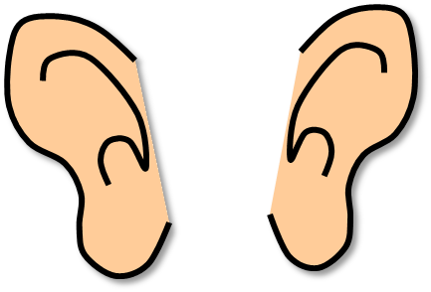
EARS
It has got big ears

Slide 20
BEARD/MOUSTACHE
It has got a big moustache

Slide 21

Thank you!
It has got a big moustache
EXIT

